Slide 1
WARNING
This collection of slides provides an idea of the course structure and key words.
It is NOT intended to substitute the readings required by the instructor.

Slide 2
TCH321 CORPORATE FINANCE Nguyen Manh Hiep 2020

Slide 3
CHAPTER 5 CAPITAL STRUCTURE Nguyen Manh Hiep

Slide 4
In this chapter:
I.
MM THEORY
III.
TRADE-OFF THEORY
IV
VII
PECKING –ORDER THEORY
DIVIDEND POLICY
EQUITY ISSUE
VI
VIIII
DEBT FINANCING
II.
INTRODUCTION
V
MARKET TIMING THEORY
IX
HOMEWORK

Slide 5
I. INTRODUCTION
Capital structure is the combination of equity and debt and other securities issued by the company to finance its activities.
Do capital structure and financing decisions affect shareholders’ value?
In a perfect market: No effects.
In reality: Yes.
How do financing decisions affect shareholders’ value?
Various theories and empirical evidence exist.

Slide 6
I. INTRODUCTION
ROE and capital structure
Example:
Mai Linh Company has đ1000 billion in debt and đ2000 billion in equity. Debt interest rate is 10%. Tax is 20%. EBIT is đ400 billion. Calculate Mai Linh’s return on equity.
Tuan Bach Company has đ2000 billion in debt and đ1000 billion in equity. Debt interest rate is 10%. Tax is 20%. EBIT is đ400 billion. Calculate Tuan Bach’s return on equity.

Slide 7
I. INTRODUCTION
ROE and capital structure
Example:
Mai Linh Company has đ1000 billion in debt and đ2000 billion in equity. Debt interest rate is 10%. Tax is 20%. EBIT is đ200 billion. Calculate Mai Linh’s return on equity.
Tuan Bach Company has đ2000 billion in debt and đ1000 billion in equity. Debt interest rate is 10%. Tax is 20%. EBIT is đ200 billion. Calculate Tuan Bach’s return on equity.

Slide 8
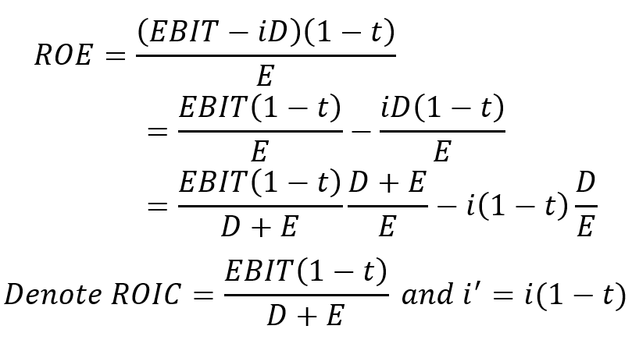
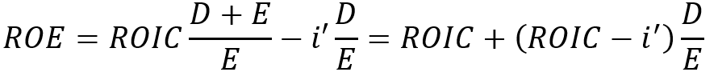
I. INTRODUCTION
ROE and capital structure

Slide 9
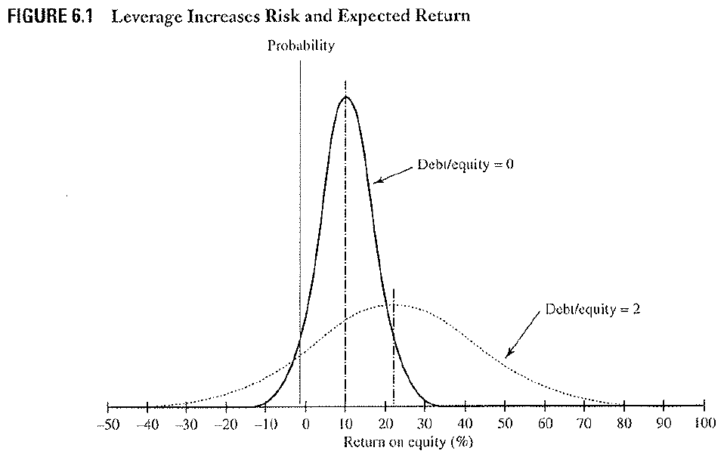
I. INTRODUCTION
ROE and capital structure
Source: Robert Higgins

Slide 10
I. INTRODUCTION
Degree of Financial Leverage (DFL)
Example:
Mai Linh Company has đ1000 billion in debt and đ2000 billion in equity. Tuan Bach Company has đ2000 billion in debt and đ1000 billion in equity. Debt interest rate is 10%. Tax is 20%. EBIT is đ300 billion. Calculate their return on equity. Mai Linh and Tuan Bach has 200 million shares and 100 million shares outstanding.
What is the percentage change in EPS when EBIT of both companies increases / decreases to đ400/200 billion?
Draw a graph showing the relationship between EBIT and EPS of both firms in the same coordinate system.

Slide 11
II. MM THEORY
Assumptions
Perfect capital market (no transaction costs, no information asymmetry, REM investors, homogenous expectations).
Individuals and corporations lend and borrow at risk-free interest rate.

Slide 12
II. MM THEORY
Mai Linh has the following project. r_{f} = 5%, required rate of return 15%.
Year 0 | Year 1
 | Good (50%) | Bad (50%)
-$800 | $1400 | $900

Slide 13
II. MM THEORY
Mai Linh raises 100% equity to invest. She can sell equity at $1000.
Equity risk: 40%-(-10%)=-50%
Equity risk premium: 15% - 5% = 10%
 | Year 0 | Year 1
 |  | Good | Bad
Unlevered Equity r_{E} = r_{A} = 15% | $1000 | $1400 (r = 40%) | $900 (r=-10%)

Slide 14
II. MM THEORY
Mai Linh raises 50% equity and 50% debt.
Equity risk: 75% - (-25%) = 100%
Equity risk premium: 25% - 5% = 20%
 | Year 0 | Year 1
 |  | Good | Bad
Firm assets r_{A} = 15% | $1000 | $1400 | $900
Debt r_{D} = r_{f} = 5% | $500 | $525 (r = 5%) | $525 (r = 5%)
Levered Equity r_{E} = 25% > r_{A} | $500 | $875 (r = 75%) | $375 (r=-25%)

Slide 15
II. MM THEORY
MM proposition 1: Firm value (and thus shareholders’ value) is not affected by the choice of capital structure. When the firm increases the use of debt, cost of equity increases accordingly.
See more: Modigliani, Franco và Merton H. Miller (1968), “The Cost of Capital, Corporate Finance, and the Theory of Investment”, American Economic Review 48.
V_{L} = V_{U} = EBIT / r_{U}
r_{E} = r_{U} + (r_{U} – r_{D}) * D/E
WACC = E/V * r_{E} +D/V * r_{D}
WACC = r_{U} = r_{A}

Slide 16
II. MM THEORY
Cash (and so does other risk-free securities) reduces investor’s required rate of return on the firm and is considered as “negative debt”.
Net debt = Debt – Cash.

Slide 17
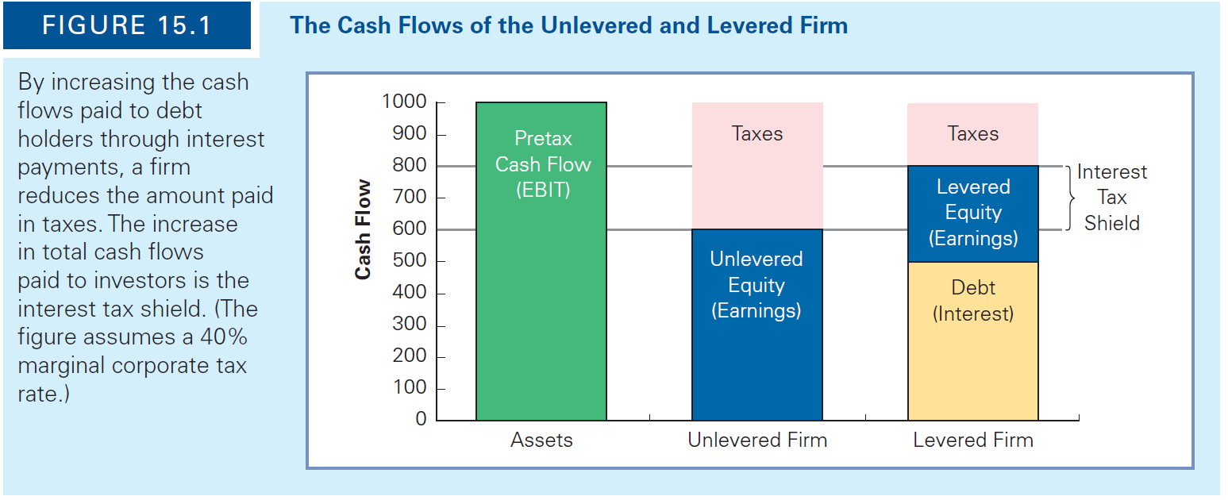
II. MM THEORY
Taxes
Cash flows to investors with leverage = cash flows to investors without leverage + interest tax shield.
Source: Berk, DeMarzo

Slide 18
II. MM THEORY
Tax 30%. $10 per share
Equity risk: ?
Equity risk premium: ?
EPS=? (in each case)
No debt | Year 0 | Year 1
 |  | Good | Bad
 |  | $1400 | $900
Tax |  | ? | ?
Unlevered Equity | $980 | ? | ?

Slide 19
II. MM THEORY
With 50% debt | Year 0 | Year 1
 |  | Good | Bad
 | 980 | $1400 | $900
Interest expense |  | -(490*5%) = -24.5 | -(490*5%) = -24.5
Tax |  | -(1400-980-24.5) * 0.3 = -118.65 | (900-980-24.5) * 0.3 = 31.35
Debt (principal) | $490 | 490 | 490
Equity | $490 | 1400-24.5-118.65-490 | 900-24.5+31.35-490
Risk-adjusted return |  | (equity/equity y0)-1 | (equity/equity y0)-1
Tax shield
Equity risk:
Equity risk premium: ?
Equity value: ?
EPS=? (in each case)

Slide 20
II. MM THEORY
MM Proposition 2: Firm value and thus shareholders’ value increases with the use of debt.
V^{L} = V^{U} + PV(Interest Tax Shield)
PV(Int. Tax Shield) = τ_{C} * D
V^{U} = EBIT*(1- τ_{C}) / r_{U}
r_{E} = r_{U} + (r_{U} – r_{D}) * D/E * (1- τ_{C})
r_{WACC} = E/V * r_{E} +D/V * r_{D}* (1- τ_{C})
What is the optimal level of debt?

Slide 21
III. TRADE-OFF THEORY
Financial distress costs damage shareholders’ and debtholders’ value. They are 10-20% of firm value.
Direct costs from 3%-10% of a firm’s assets. Indirect costs are substantial.
Even the high probability of financial distress may impose indirect costs.
Lenders ex ante require higher interest.
Bradley, M. và G. A. Jarrell và E. H. Kim (1984). “On the Existence of an Optimal Capital Structure: Theory and Evidence”. Journal of Finance 39.
Andrade, G. & Kaplan, S. (1998). “How Costly Is Financial (Not Economic) Distress? Evidence from Highly Leveraged Transactions That Became Distressed, Journal of Finance 53.

Slide 22
III. TRADE-OFF THEORY
Financial distress cost components
Expected bankruptcy costs equal probability times costs incurred if bankruptcy happens.
Which company loses more value in a bankruptcy, a value company with mostly physical assets or a growth company whose value comes mostly from growth potential?
Implicit costs.
Predict how creditors, customers and suppliers react if they realize that a company is near financial distress.
Predict ex ante action of the managers with regard to cash holding.
Distorted investment decisions due to conflicts of interest (see the examples in Chapter 1).

Slide 23
III. TRADE-OFF THEORY
Example
Tuan Bach Inc. and Mai Linh Co. are two leading competitors who provide highly substitutable products, each occupies 40% market share.
Due to excessive growth and heavy debt burden, Mai Linh is on the brink of bankruptcy with cash flows barely enough to pay its debt.
Tuan Bach has abundant of cash reserve, healthy cash flows and little debt.
What should Tuan Bach do?

Slide 24
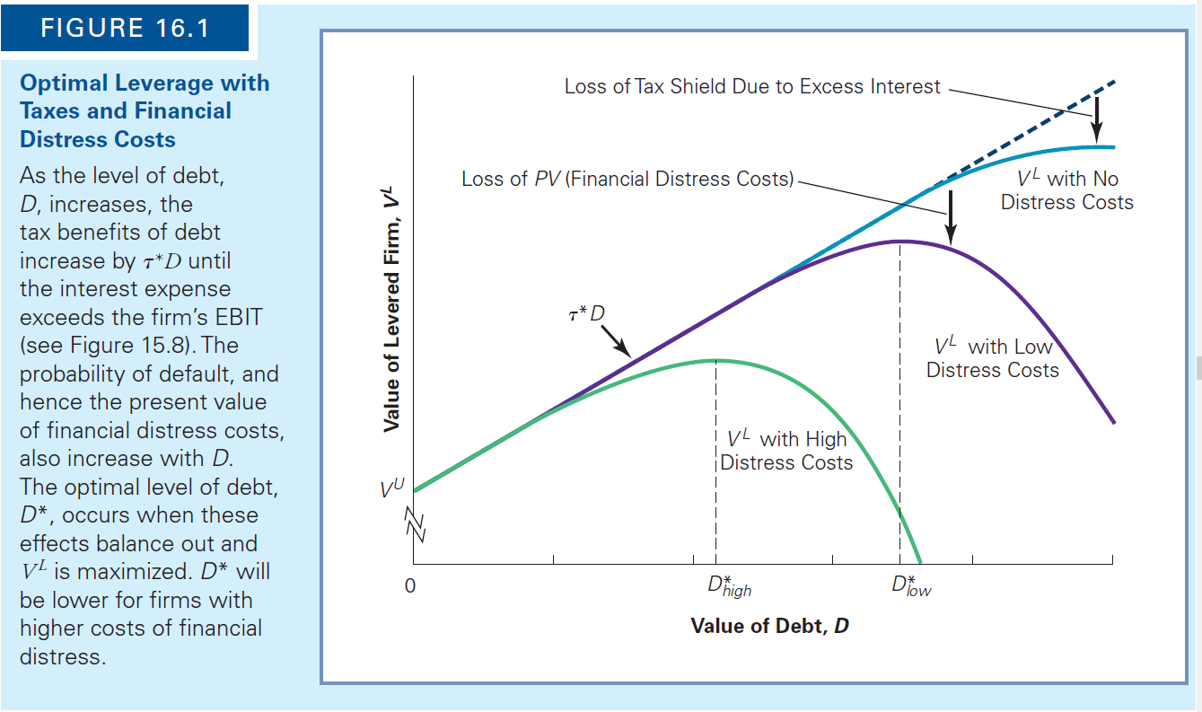
III. TRADE-OFF THEORY
Source: Berk, DeMarzo

Slide 25
III. TRADE-OFF THEORY
Benefits of high leverage
Concentration of ownership.
Reduction of wasteful investments and activities.
Higher pressure on and commitments by management.
Restrictions by debt covenants and additional monitoring from debtors.

Slide 26
III. TRADE-OFF THEORY
V^{L} = V^{U} + PV(tax shield) - PV(financial distress costs) - PV(agency costs of debt) + PV(agency benefits of debt)

Slide 27
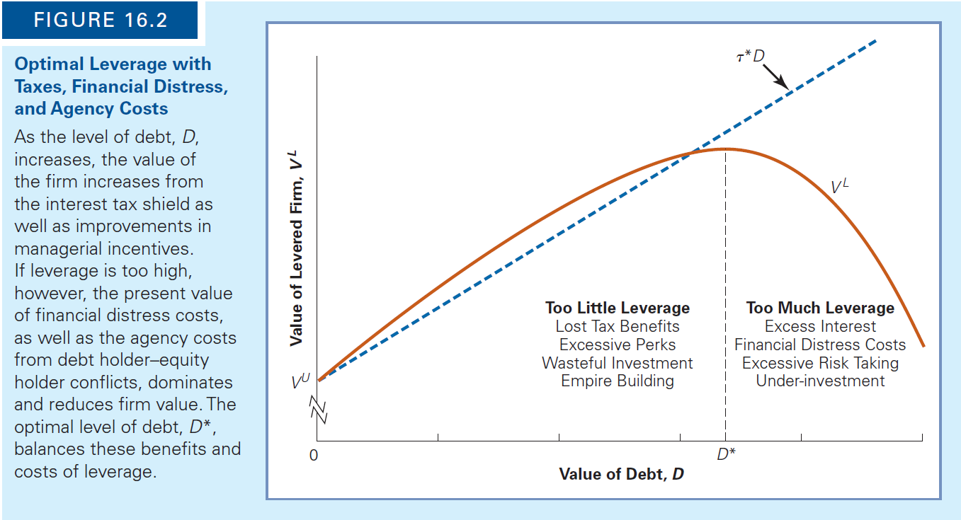
III. TRADE-OFF THEORY
Source: Berk, DeMarzo

Slide 28
III. TRADE-OFF THEORY
Example: Which of the following is likely to use more debt?
A firm with high intangible assets, R&D-intensive, human-capital-intensive, high-growth, unstable cash flows.
A firm with high tangible assets, low-growth, stable cash-flows.

Slide 29
IV. PECKING ORDER THEORY
Equity issuance conveys a negative signal (why?), leading to a significant loss in shareholder value.
Asquith, P., & Mullins, D. W. (1986). Equity issues and offering dilution. Journal of Financial Economics, 15(1-2), 61–89.
Retain earnings first, debt second, equity last.
Myers, S. C. (1984). “The Capital Structure Puzzle”. Journal of Finance 39.
Example: For firms unwilling to sell equity (small firms, family firms, firms of strategic importance to owner, undervalued firms…), what det ermine their growth?

Slide 30
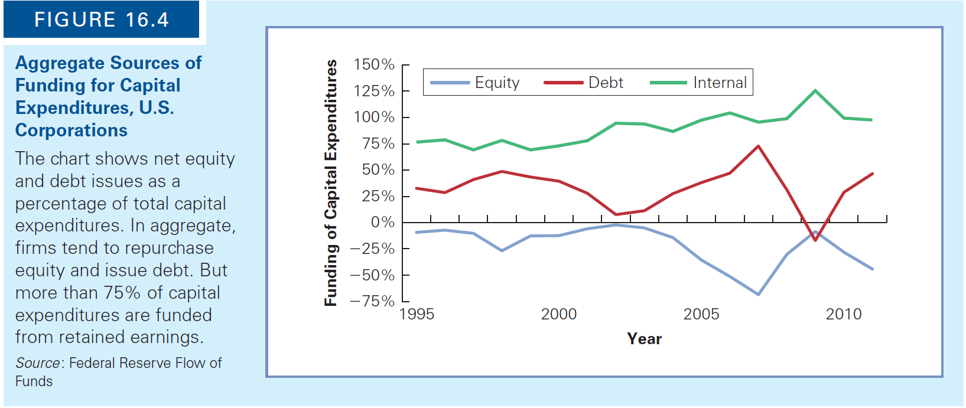
IV. PECKING ORDER THEORY
Source: Berk, DeMarzo

Slide 31
V. MARKET TIMING THEORY
The choice of debt and equity depends on market condition.
Baker, M và J. Wurgler (2002), Market Timing and Capital Structure, Journal of Finance 57.
Debondt, W. F. M. và R. Thaler (1985), Does the Stock Market Overreact?, Journal of Finance 40.
Example:
2002-2007: Vietnamese listed companies raises around 40% external funding from share issues.
2008-2011: Only 20% of external funding is from share issues.

Slide 32
*SUM UP THE THEORY
Rapidly growing firms
Low or high leverage?
Low or high dividend payout?
How to finance if investment needs exceed internal funds?
What to do if external funding is exhausted?
McConnell, J. J., & Servaes, H. (1995). Equity ownership and the two faces of debt. Journal of financial economics, 39(1), 131-157.

Slide 33
*SUM UP THE THEORY
Low growth, matured firms
Use more leverage. Buy back shares or pay more dividend.
McConnell, J. J., & Servaes, H. (1995). Equity ownership and the two faces of debt. Journal of financial economics, 39(1), 131-157.

Slide 34
VI. EQUITY FUNDING
Seed stage
“Angel” investors (Ex: Shark tanks)
Private equity
“Angel” investors.
Venture capital.
Private equity funds.
Going public
IPO.
SEO.
Private placement.

Slide 35
VII. DEBT FUNDING
Bank loans
Bonds
Pros and cos?

Slide 36
VII. DEBT FUNDING
Example:
What are the typical maturity structure of debt?
Should debt maturity match asset maturity or should it be longer/shorter? Pros and cos of each choice?

Slide 37
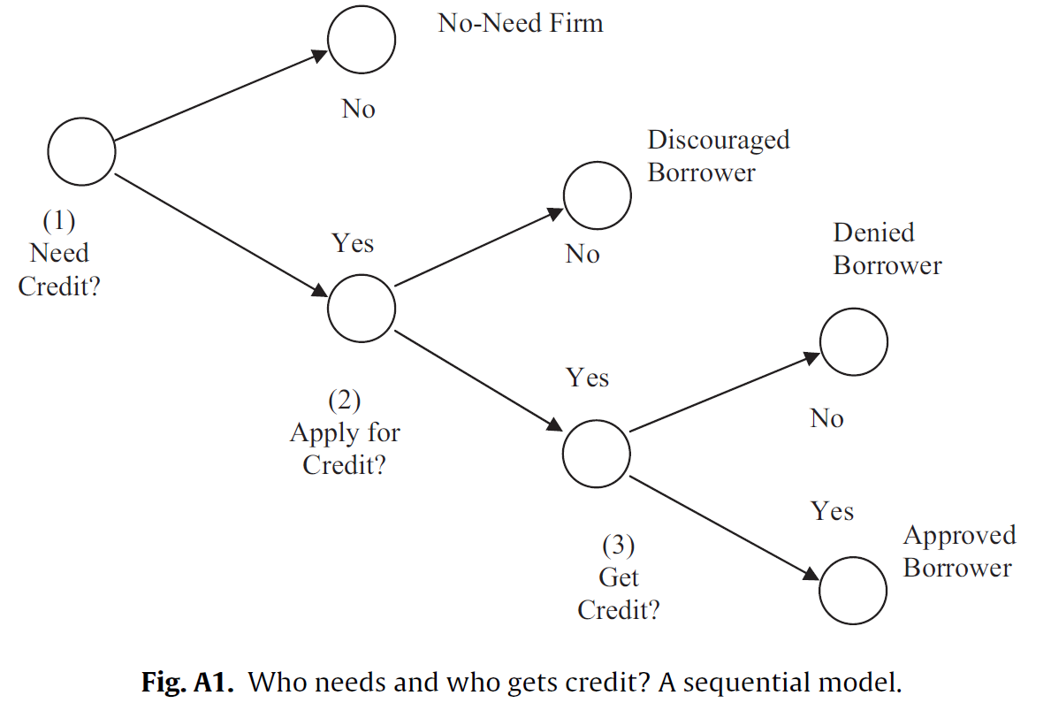
VII. DEBT FUNDING
Bank credit decision
Why don’t firm apply for bank loans?
Source: Cole, Sokolyk (2016)

Slide 38
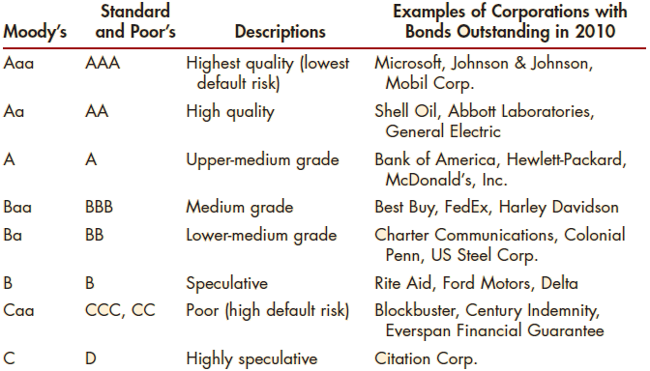
VII. DEBT FUNDING

Slide 39
VII. DEBT FUNDING
 | Moody’s | S&P
 | P-1 | A-1
 | P-2 | A-2
 | P-3 | A-3
 | NP | B
 |  | C
 |  | D
Increasing default risk

